Slide 1
Hotel Bookings
Friday, July 5, 2025
By Ahmad Alqaisi

Slide 2
Outlines
Getting Familiar with Data
Data Preparation and Transformation
Descriptive statistical data analysis
Market Segmentation Analysis
Bookings Status Over Time Analysis
Average Price and Utility Analysis
Conclusion

Slide 3
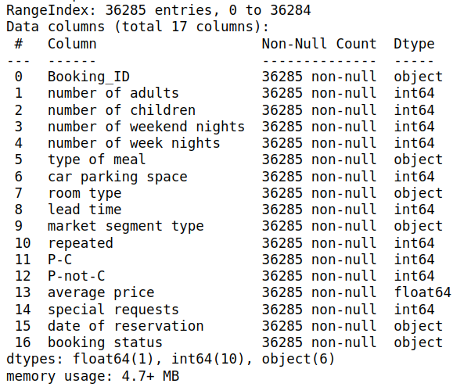
Getting Familiar with Data
This shows the structure of the dataset. It has a shape of (36285 rows, 17 columns) with-out any missing values.
11 of them are quantitative variables (including binary ones) and rest are qualitative variables (including the identifier and date columns).

Slide 4
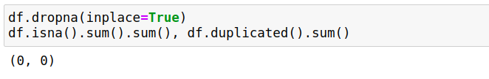
Data Preparation and Transformation
In this phase we cast the binary integer variable into categorical variables as well as checking for any duplicated row or missing values.
Then, we converted the date of registration attribute into standard pandas datetime object for consistency, since it has multiple formats, and easier use. And any wrong entered date (e.g. 2018/2/29) is discarded. Warning
For probability of cancellation and not cancellation (P-C and P-not-C) values are inconsistent (e.g. the summation of the corresponding values should be equal to 100% which is not hold) and for this purpose they will be discard from this analysis.

Slide 5
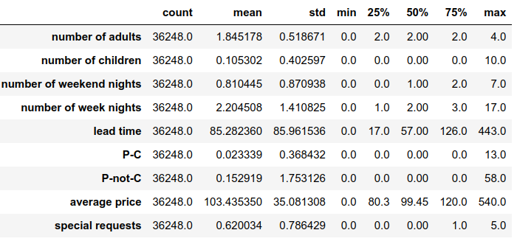
Descriptive statistical data analysis
Well, that reveals a lot! First of all, the number of adults are ranging from 0 to 4 adults with a majority of 2 adults in each booking observation. For the number of childrens, the maximum number of childrens were 10 childrens and almost of bookings were limited to adults (no childrens).
Weekend stays typically range from 0 to 2 nights, with some extending up to 7 nights and the same for number of week nights, it stays range from 0 to 3 with some exceptions going up to 17 nights.

Slide 6
Cont.
Most bookings, more than half, do not include special requests, with some having up to 5 requests.
The average prices are normally distributed and they have almost symmetric belled shape, with prices mean of 103.
The median lead time is approximately 57 days with a high variability as indicated by a standard deviation of 85.94 days. The values are ranging from 0, indicating some bookings are made for immediate arrivals and 443 days, indicating some bookings made in advance.

Slide 7
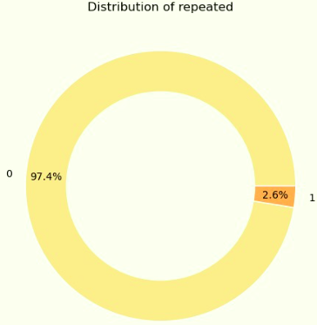
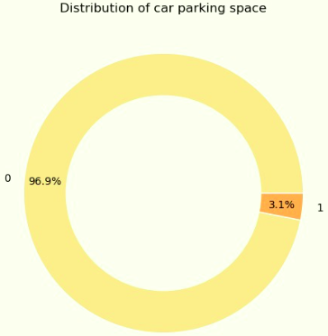


Cont.
For both, car parking space and repeated, a very small proportion of 3% were found with a space for car parking and they are not repeated bookings.

Slide 8
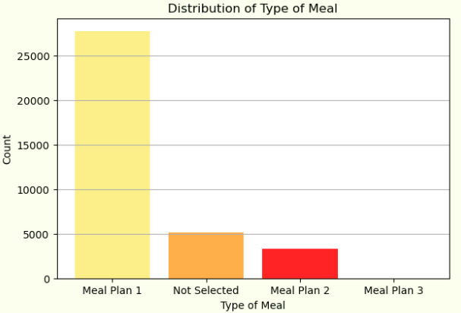
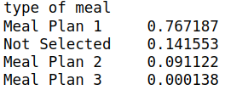
Cont.
Also, there are 3 primarily meal plans, plan 1, 2, and 3. There is an option for non selected plan. The majority of 77% bookings were with a plan 1. 14% of them did not select any meal plan. The last 9% were found with plan 2 and a very small percentage, 0.01, of bookings were booked with plan meal 3.

Slide 9
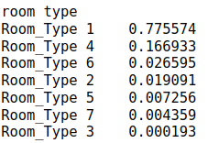
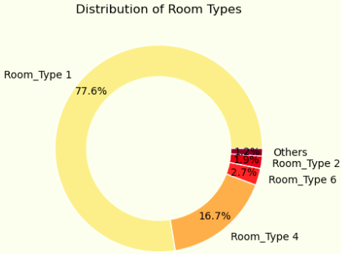
Cont.
For type of rooms there are 7 types. The most popular room type booked was rooms of type 1, with a percentage of 77% and 17% for rooms of type 4. The last 6% was distributed among the room types.

Slide 10
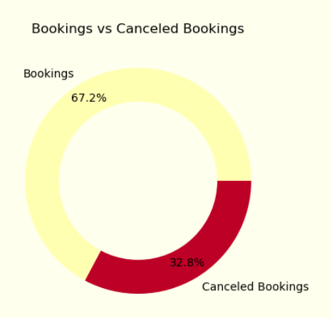

cont.
Well about 33% of booking are cancelled in fact it is not a small ratio!

Slide 11
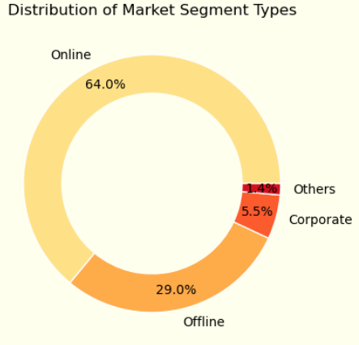
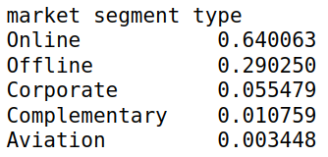
cont.
Well, the majority of bookings, 64%, were made through online channels, making it the most popular choice, likely due to their accessibility. A significant portion of bookings, 29%, were made offline. Corporate bookings account for 5.56% of the total. This segment consists of business travelers whose stays are often arranged through company accounts or corporate travel agencies. The last proportion segment, about 1.5%, were for complementary and aviation bookings.

Slide 12
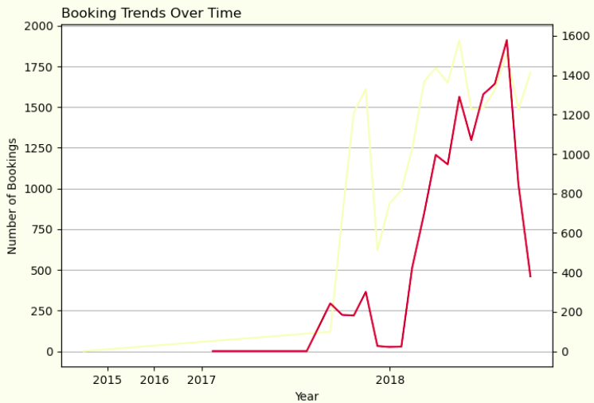
Bookings Status Over Time Analysis
Well, about 33% of booking are canceled, in fact it is not a small ratio! so, let's dive deeply in our analysis.
As shown here, there was a relative increasing in the number of booking, from 2015 until mid-2017. Then, a significant increasing in the number of booking until the end of November 2017 which is with sharp decline in the number of bookings until the beginning of 2018. From 2015 there was a relatively stable number of canceled booking until 2018, which get also increased as the number of bookings were increased in general.

Slide 13
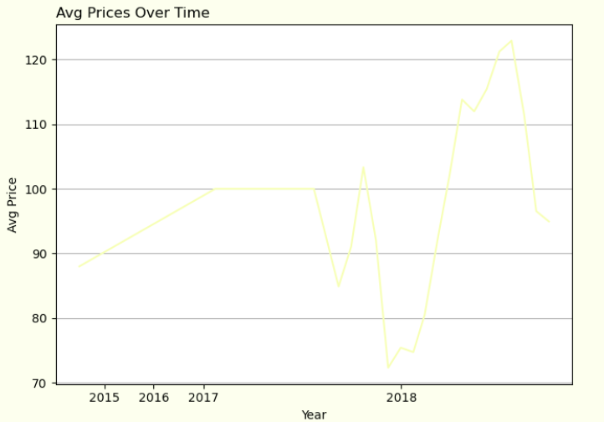
Cont.
In fact, there is a strong positive relationship about 0.79 between the number of canceled bookings and average prices, as the average prices increases the number of booking cancelation is also increases.

Slide 14
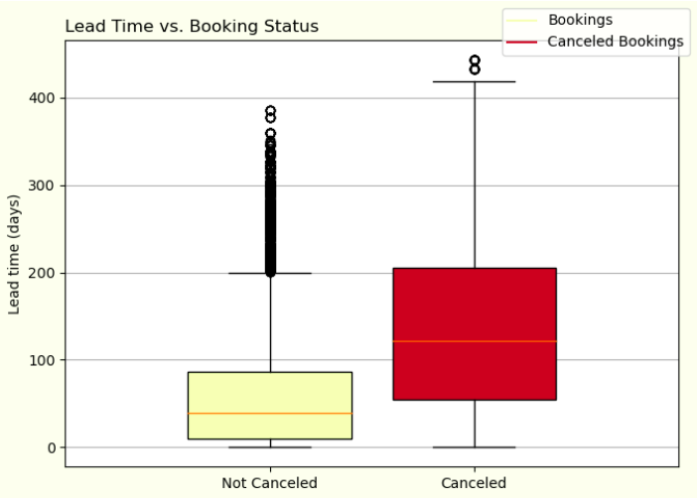
Cont.
In the boxplot above, it is clearly shown that the impact of the duration time on the likelihood of booking to be canceled, since the boxplot that representing the canceled bookings has a bigger range and the data points are spread in that range.

Slide 15
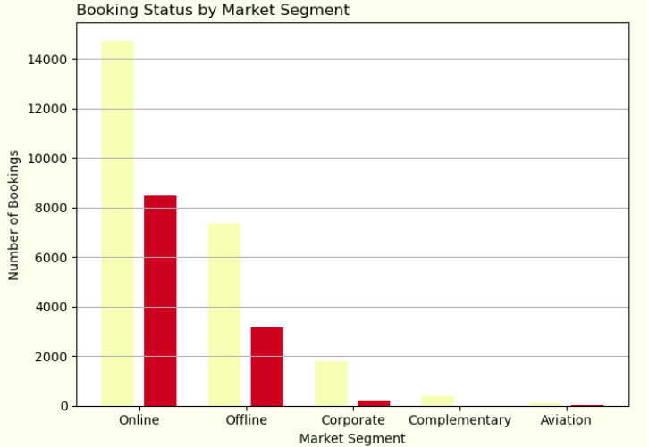
Cont.
Finally, the majority of bookings are done and canceled online platforms, due to their accessibility and its usability than offline or traditional methods.

Slide 16
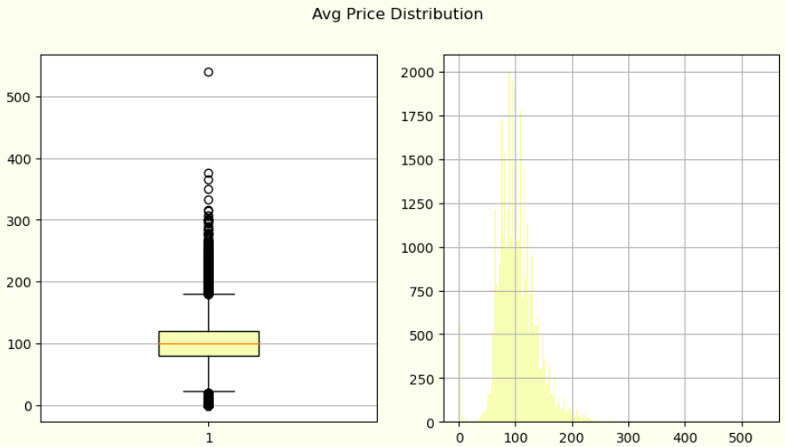
Average Price Analysis
There are multiple factors that can affect the booking price, including length of stay, type of meal, the special requests and more.
The average prices are normally distributed from 30 to 180 with relatively small outliers with prices up to 500.

Slide 17
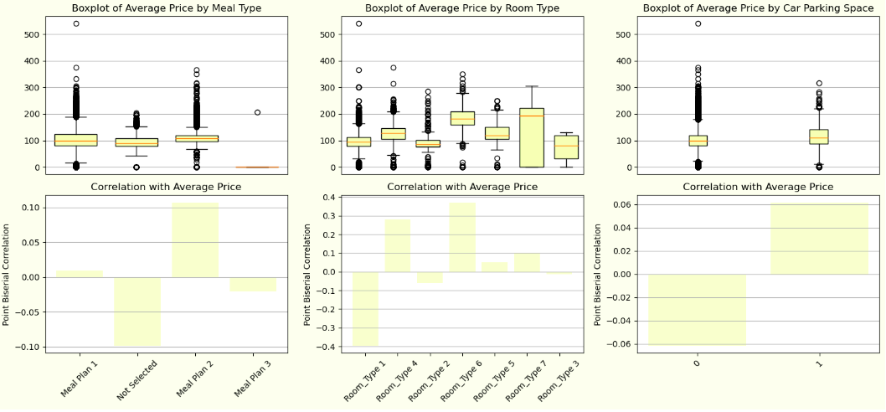
Utility Analysis
The variability in data may due to request some special utilization such as requesting for space car parking, highly cost meal plan or any something else which will explained in the following chart.

Slide 18
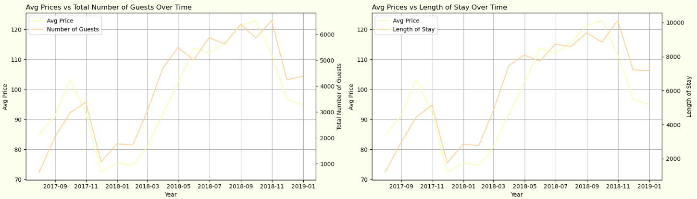
Cont.
As we seen before, there was a disruption in average booking prices from mid-2017 to the end of 2018. So, let's turn our focus in this interval:

Slide 19
Cont.
Well, maybe these results are not very exciting since it is obvious that the more people in the booking, the more staying time, the more the cost!
But from this chart we can ensure that the primary factor on the price is both, the number of bookers and stay time:
Correlation coefficient between average prices and Total Number of Bookers between mid of 2017 and 2018: 0.87
Correlation coefficient between average prices and Staying Period between mid of 2017 and 2018: 0.85

Slide 20
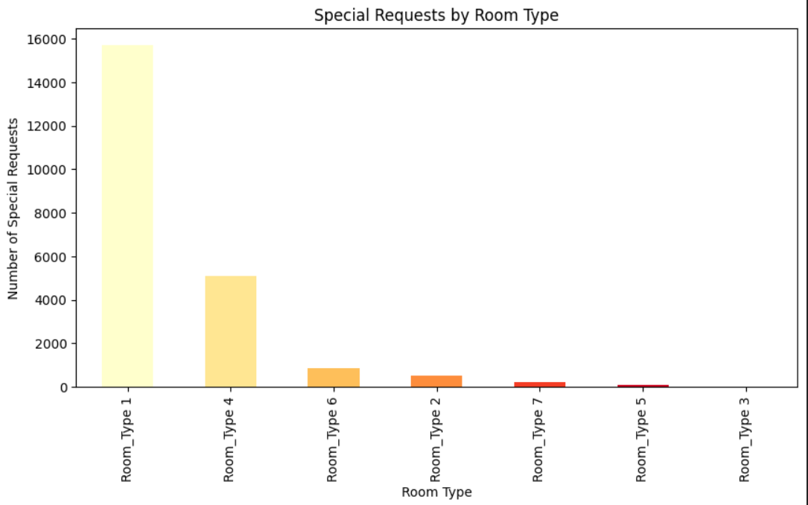
Special Requests By Room Types
The bar chart analyzes special requests by room type. Room type 1 has the most requests, followed by room types 4 and 2. This suggests guests in room type 1 frequently request additional services or amenities. By understanding these preferences, the hotel can tailor its offerings to better serve guests in different rooms.

Slide 21
Thank you

